Slide 1
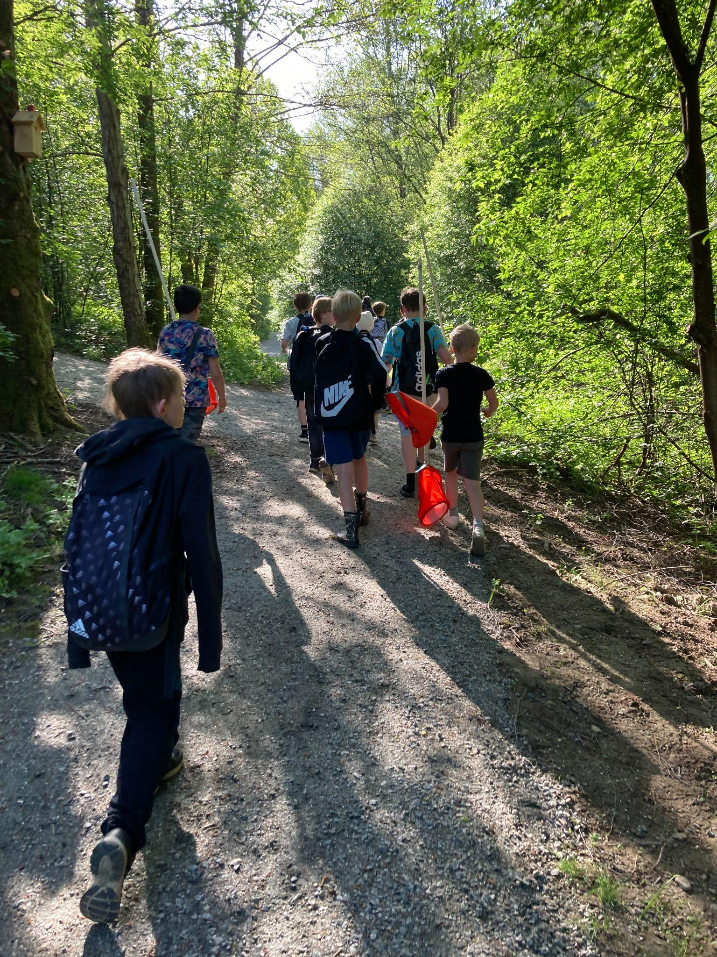
Water Day
at Gadden School
2025-01-28
A presentation of a collaboration project between the Gadden school, the water council and Sweden's anglers association together with three other schools in the catchment area, with the aim of developing new methods for shared learning 2023-2026.

Slide 2
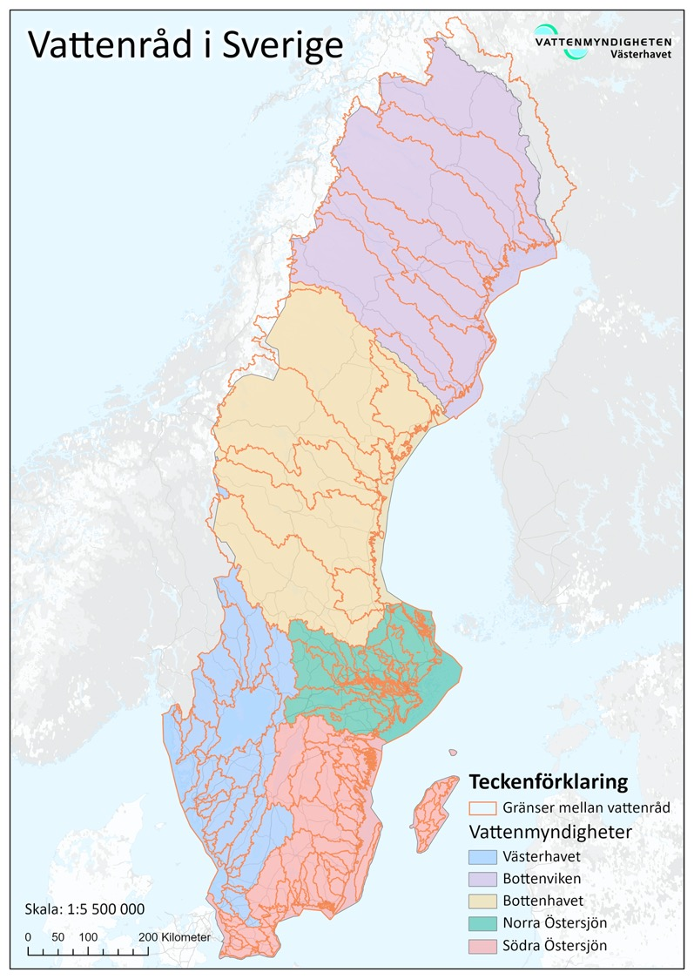
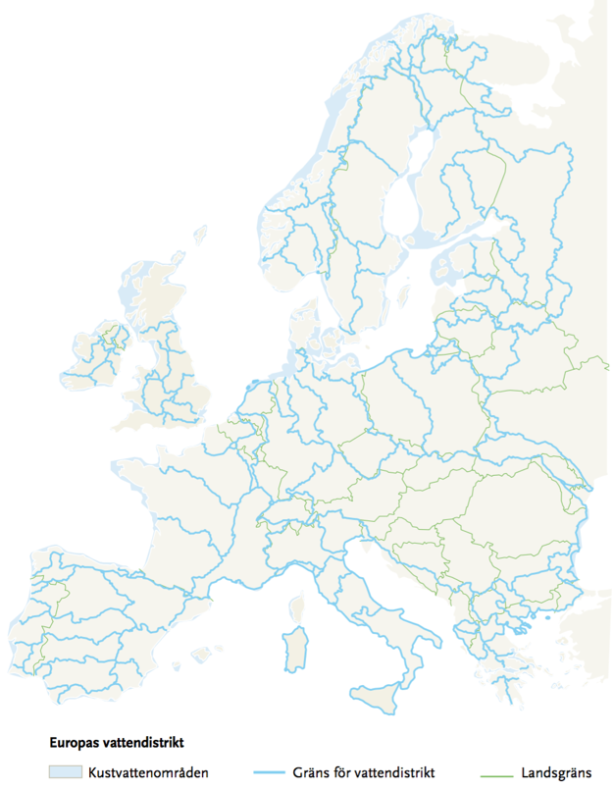
EU Water Framework Directive
from 2000
Water Council in Sweden
as well as river basins
and coastal areas
” Water is not just any commodity but a heritage that must be protected, defended and treated as such.”
Water Districts
in EU
Keywords
Local participation
Collaboration
Holistic approach
Water Authority in the Skagerrak and Kattegat Water District
Rolfsån
catchment area
Notes:
Vi berörs av EU:s ramdirektiv för vatten
Europa är indelat i vattendistrikt efter vattendelare
I Sverige finns fem vattendistrikt och kopplat till dem fem vattenmyndigheter
Sverige är indelat i huvudavrinnginsområden varav Ätrans är ett
I varje avrinningsområde finns vattenråd som är en frivillig sammanslutning för samverkan
EU:s och vattenmyndighetens arbete sker i en förvaltningscykel på 6 år. Kartläggning-mål och miljökvlitetsnormer-åtgärdsprogram-uppföljning och rapportering
Ledord är lokalt deltagande, samverkan och helhetssyn (samma som för arbete med hållbar utveckling och globala målen)

Slide 3
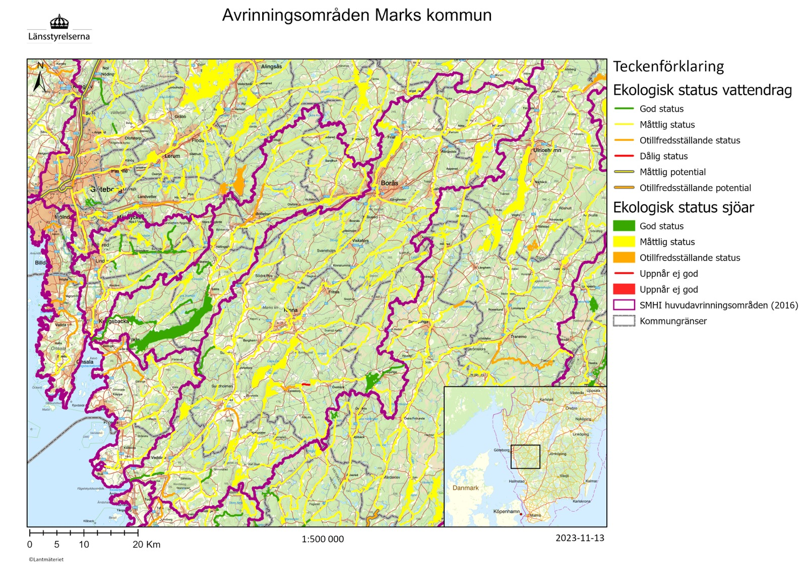
Main catchment areas
Status classification according to the Swedish Water Authority
Säveån
Ecological status - Watercourses
Action program from the Swedish Water Authority aimed at municipalities and other authorities.
Requirement to achieve good status in all water bodies by 2027.
Status must not get worse.
Mölndalsån
Ecological status - Lakes
Kungsbackaån
Ätran
Viskan
Rolfsån

Slide 4
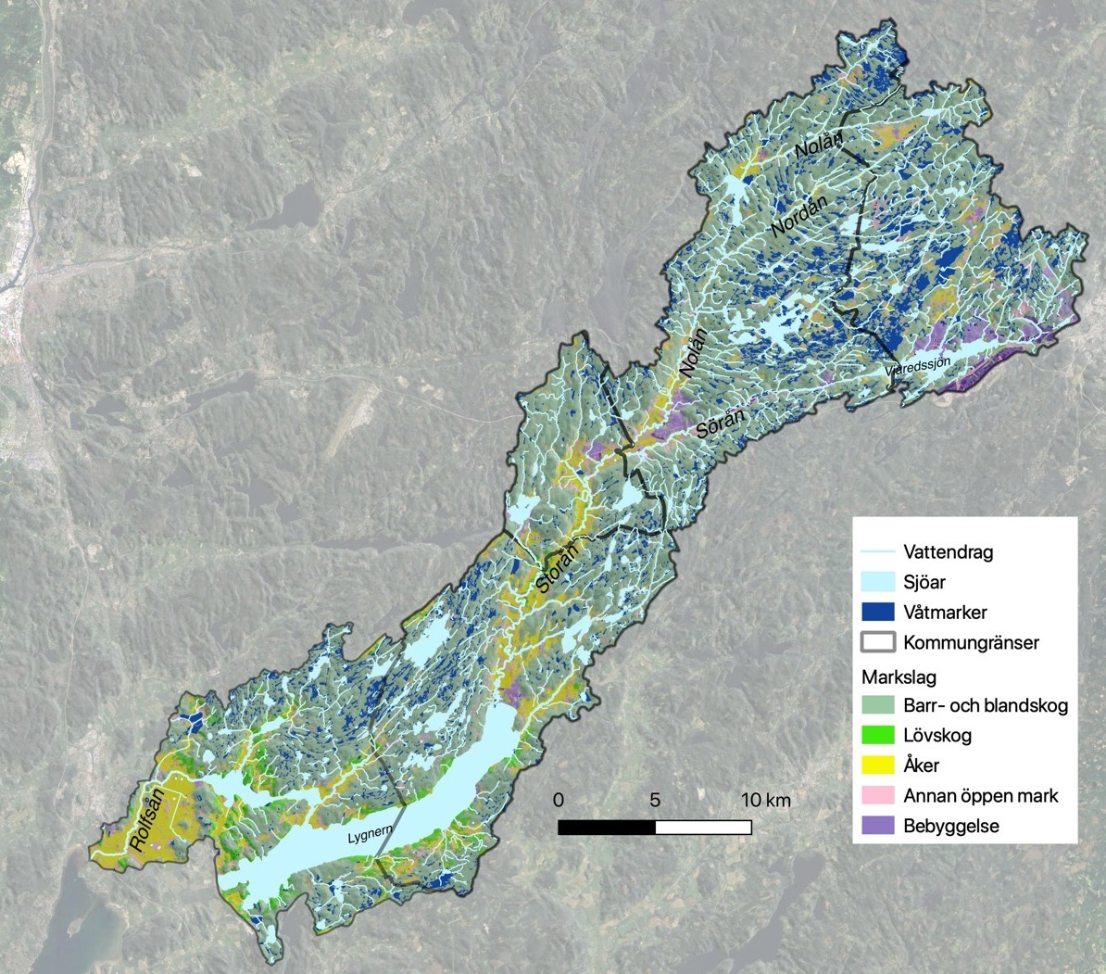
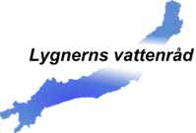
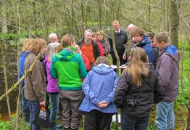
Lygnerns Water Council
Borås
Municipalities
Associations
An association open to everyone: Municipalities, companies, interest organizations and associations.
A neutral and open meeting place for cooperation around water.
Collaborates and networks with other organizations
Seeks funding for and implements projects: For example, measures in affected waters to benefit fish and the ecosystem.
Monitors water quality in the water system.
Web page: https://lygnernsvattenrad.se
Interest organizations
Landowners
County boards
Companies
Härryda
Bollebygd
Kungsbacka
Mark

Slide 5
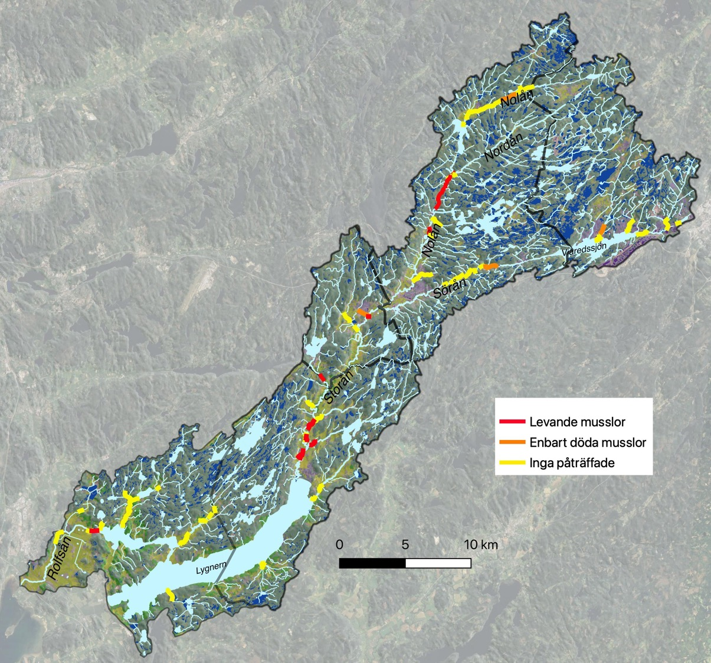
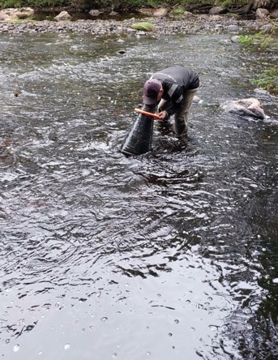
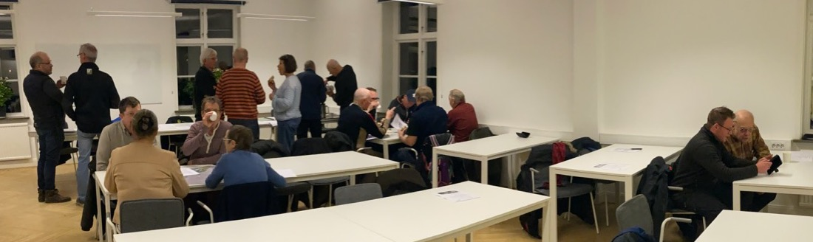
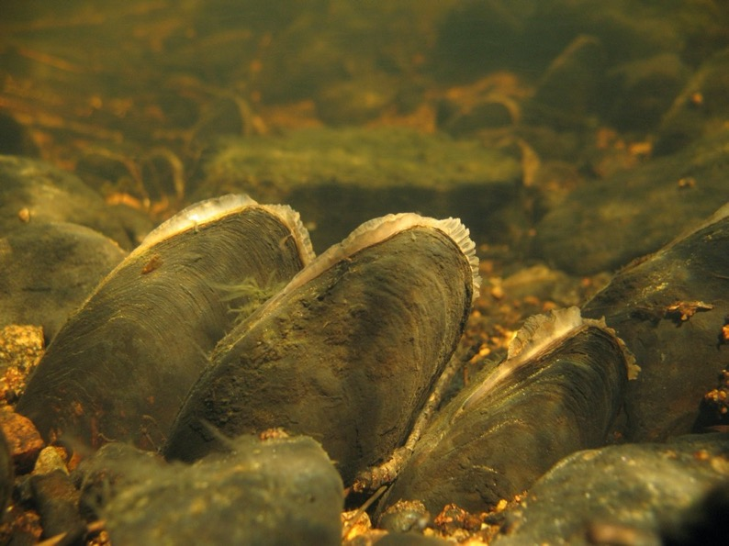

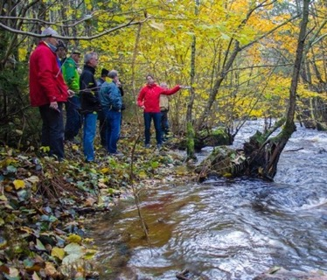
Example collaboration: Management plan
Landowners
Anglers
Municipalities
Foto: Karolina Kjellberg
- freshwater pearl mussel
Live mussels
Dead mussels only
None found

Slide 6
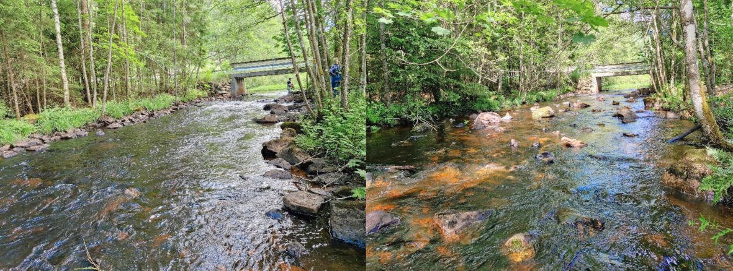
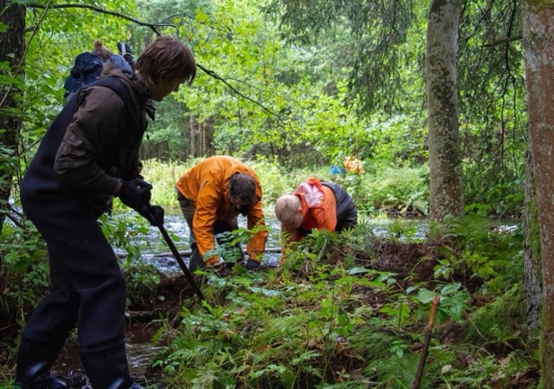
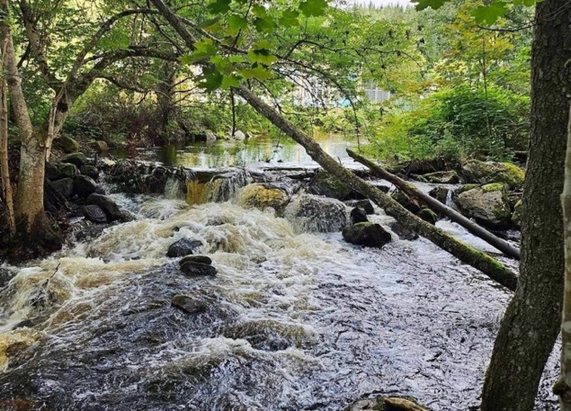
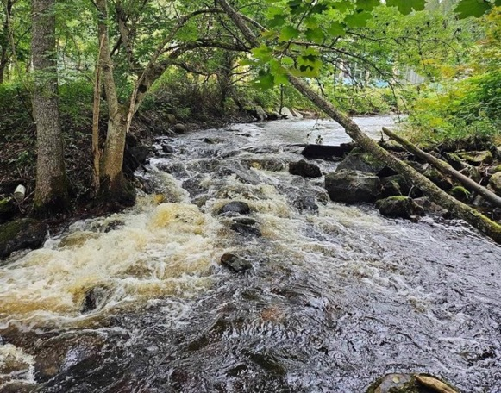
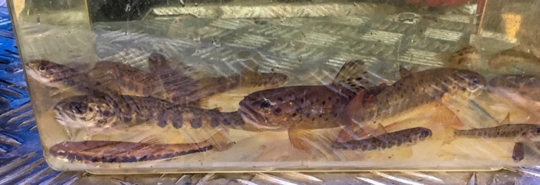
Example: biotope mapping, biotope management and removal of migration obstacles
Before
After
Foto: WaterCircle
Before
After
Foto: Ingela Danielsson
More hiding places and variety bring more life!
Foto: WaterCircle

Slide 7
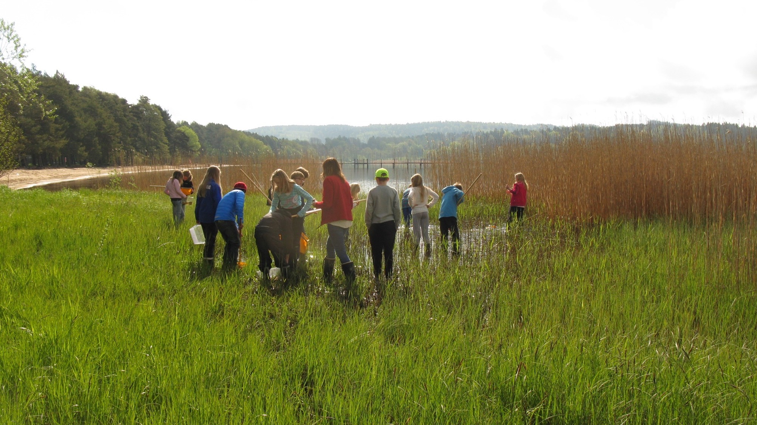

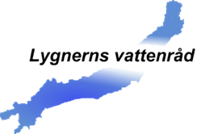


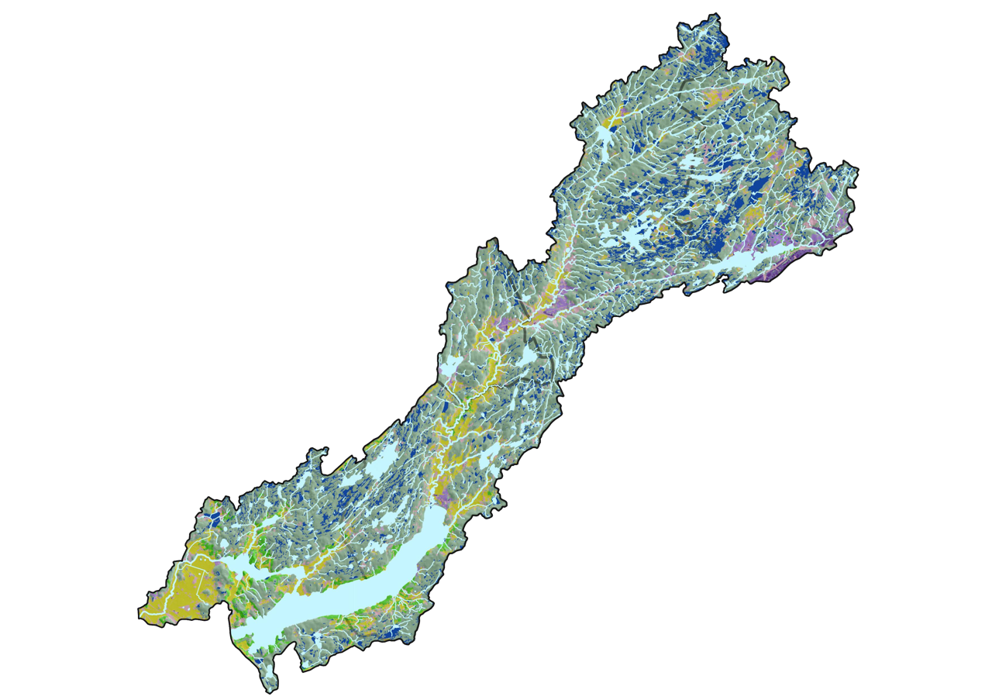
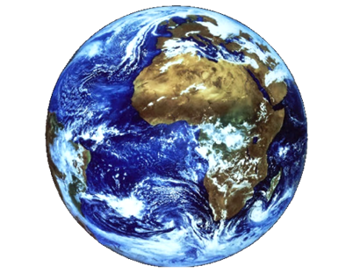

“Vattnet i skolan” and “Skolbäcken” 2023-2026
https://lygnernsvattenrad.se/vattnet-i-skolan /

Slide 8


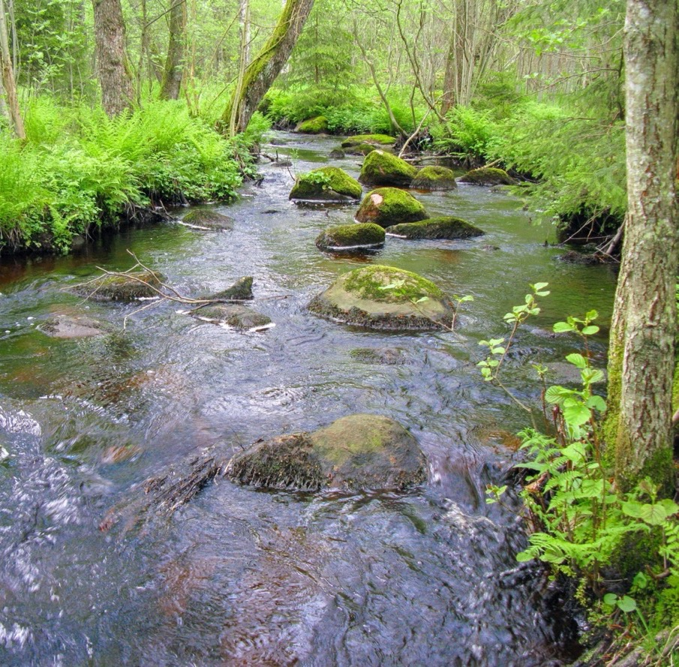
“Vattnet i skolan” and
“Skolbäcken” 2023-2026
Collaboration with the Swedish Anglers Association, to develop methods.
Water days with classes - exploring the local water
Inprovements / restauration in streams with the classes.
Education for teachers.
Develop teacher guidance that links to the school's goals.
Goals for the project:
  Support for the schools' work.
  All schools should be able to participate.
  A recurring part of the schools' work.
Schools in the catchment area and the four (red) participating in the project 2023-2026
https://lygnernsvattenrad.se/vattnet-i-skolan/
Notes:
1,25 min

Slide 9
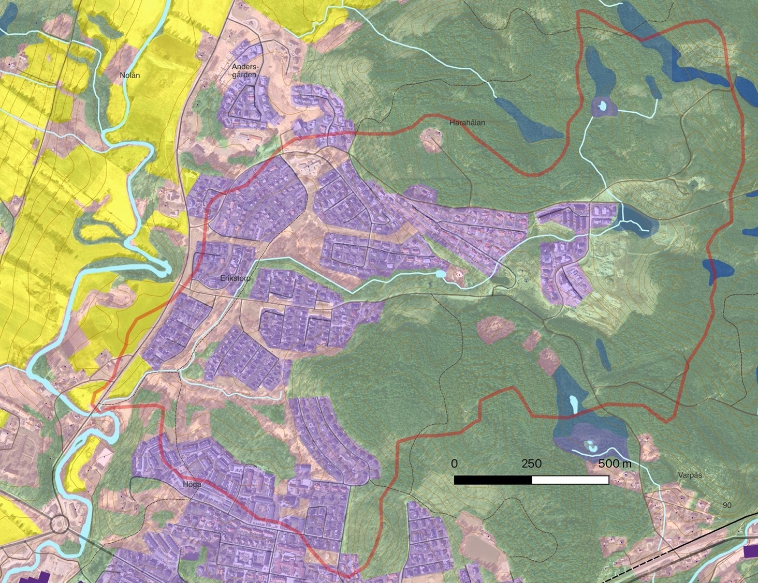
Sub-catchment area
of Erikstorpsbäcken
Gadden school

Slide 10

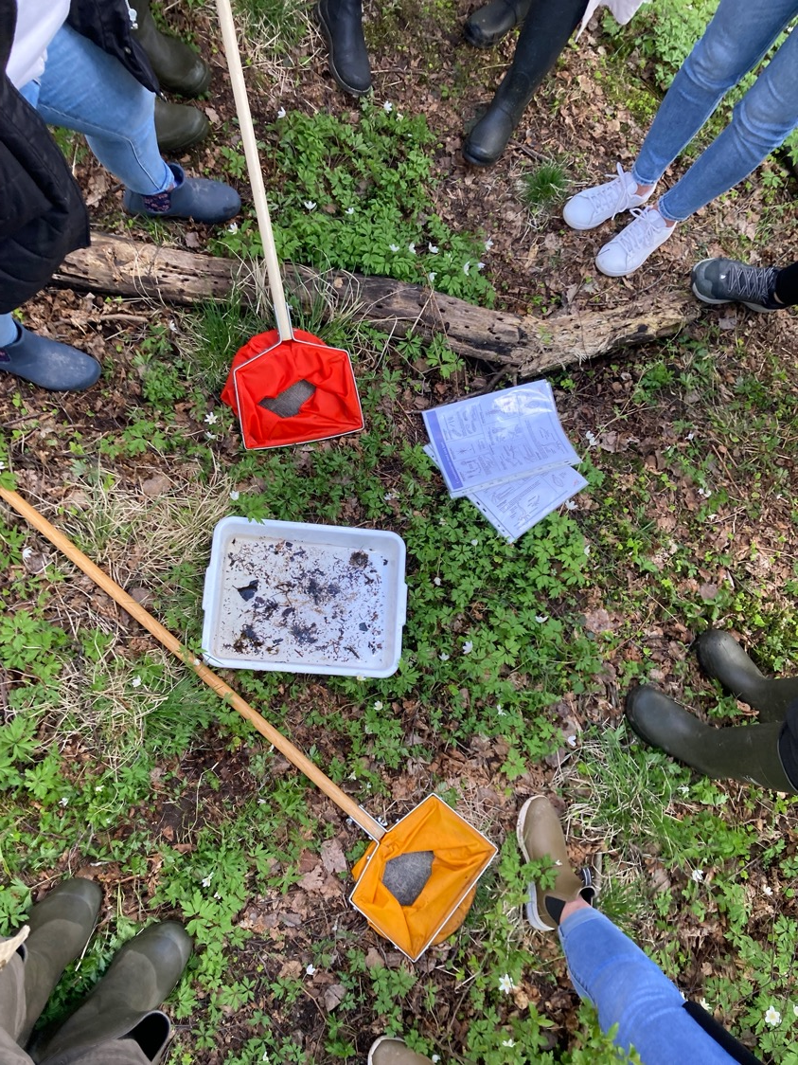
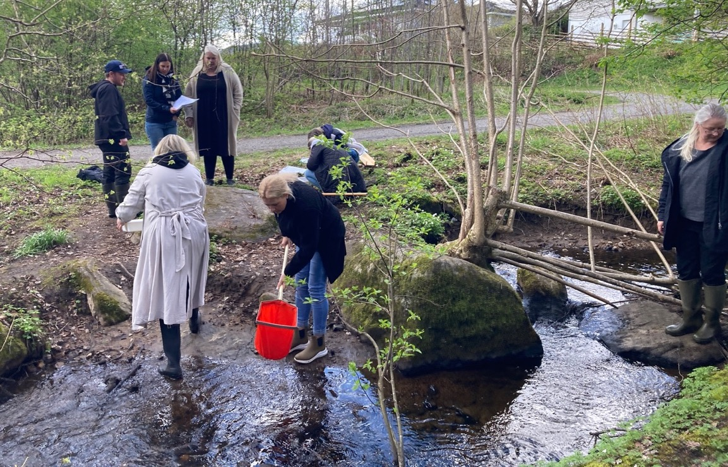
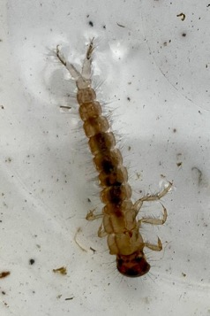
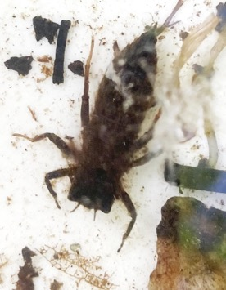
Teacher training courses Spring 2024

Slide 11
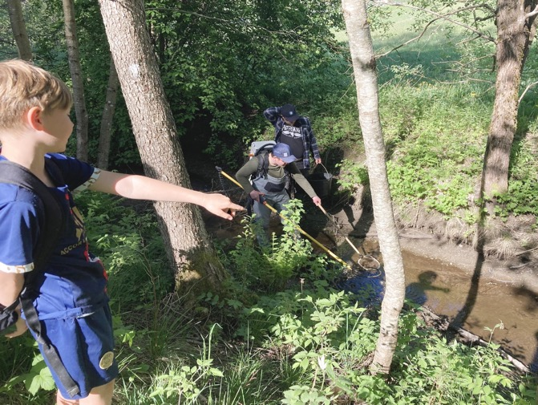
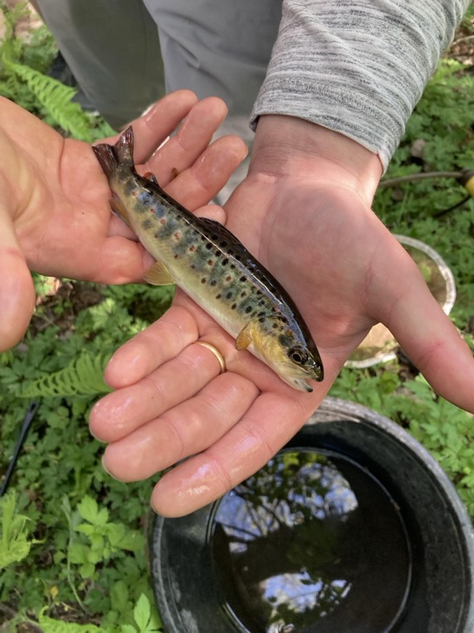
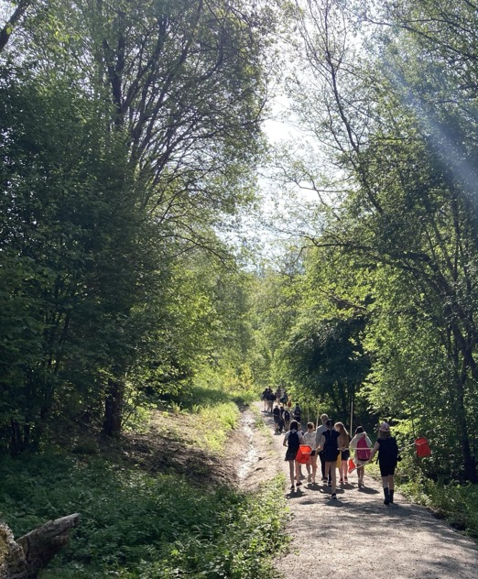
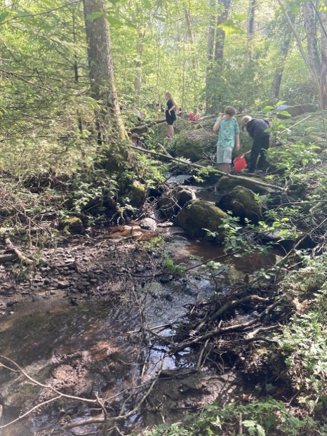
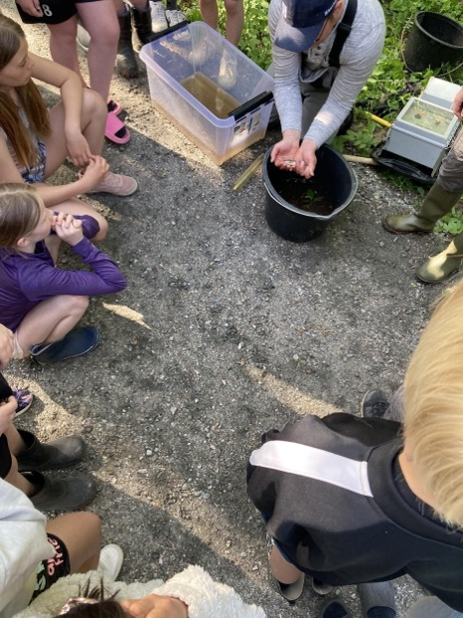
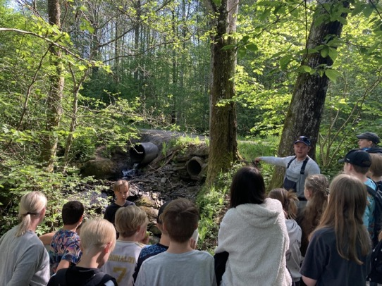
Water days with classes 2024
Grade 4 och 5
• Discovering and exploring
• What is in the water?
• Where does the water come from?
• The history of the place

Slide 12

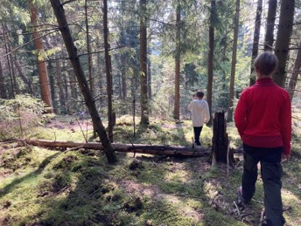
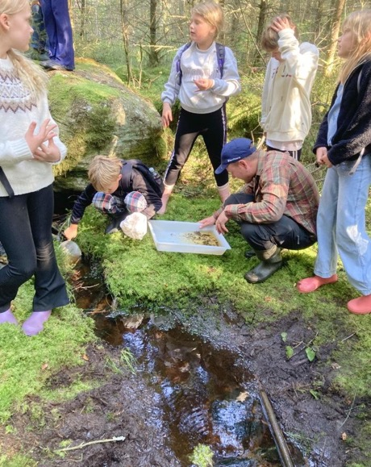
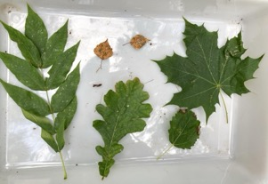
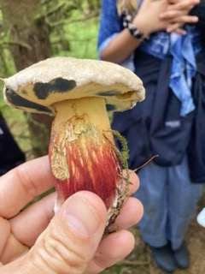
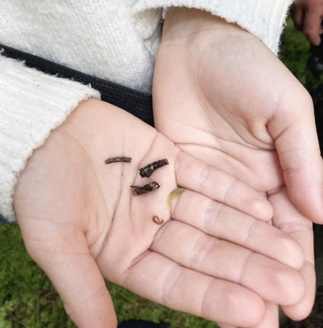
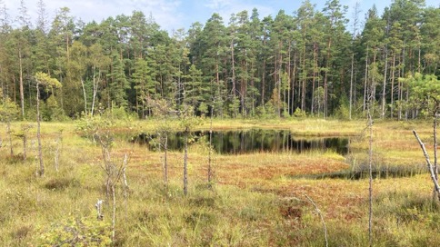
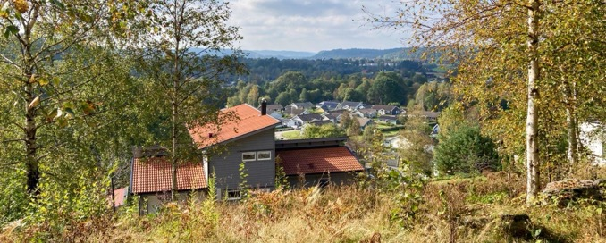
Water days with classes 2024
Grade 4 och 5
• Discovering and exploring
• What is in the water?
• Where does the water come from?
• The history of the place

Slide 13
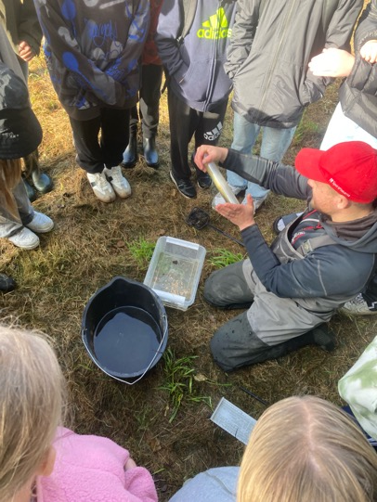
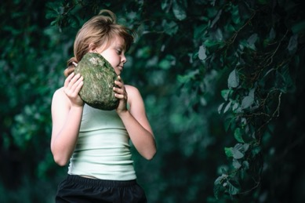
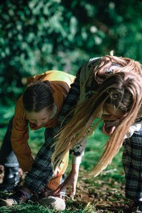
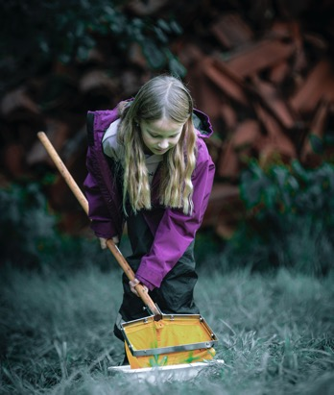
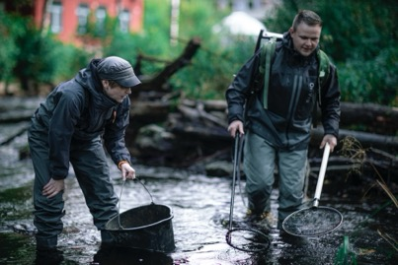
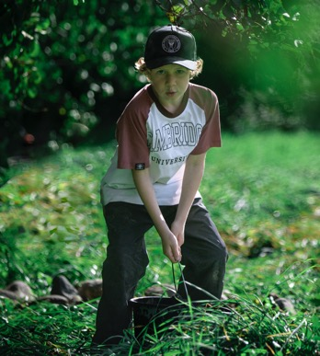
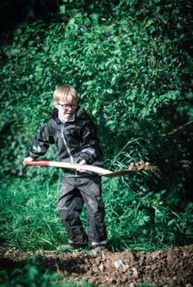
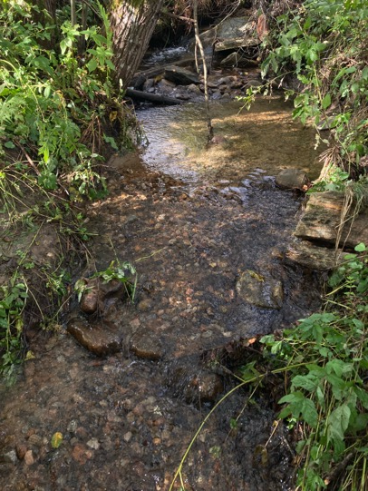
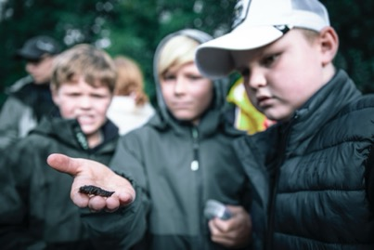
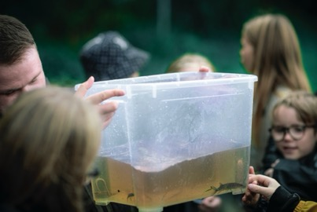
Classes take action in Kesebolsbäcken in 2023
Follow-up
Taking action
Exploring
What needs to be done?
Foto: Mathias Arnham

Slide 14











We can achieve many goals
Getting to know the local environment
Concretization, context, experiences and feelings - improved learning
Collaboration – interaction - relationship
Health - physical activity and nature experiences
It is real - knowledge of society and democracy
Action skills - entrepreneurial learning
Start locally - connect globally
Sustainable development - environmental awareness, care
The child's perspective - The child as an active part of society
Water Council
A letter asking for help and cooperation
Collaboration with the class to make environmental improvements, follow-up
The class at school
Letter to the Water Council
What have we found?
Treasures? Problems?
What do we want to improve?
Exploring

Slide 15
Workshop
Mixed two groups, about 30 min
Can we use and develop the working method at our school? What are the conditions for that?
Do we have other similar work or projects in our own schools? Tell us!

Slide 16
xxx
We don't have a stream at home but we have the opportunity to use the sea instead. The sea is very good to explore and use for studies.
We can talk about water without a stream - water is in all living things.
Difficult to find time and opportunity to get outside.
You can connect it to many subjects, language, geography, history, math
In Portugal we work with:
Eco Schools
Green flag
Landscape-lab
Tips on websites used in Turkey:
Blue school EU
European atlas of the sea
European Schoolnet Academy
European Schoolnet
Scientix

Slide 17
Workshop
The hole group
What do we take home from the day?
Have you got any special ideas that you want to develop further?

Slide 18
We have good conditions for outdoor activities as we have a park close to the school and also several institutions that work with the environment that they can create collaborations with.
We want to be more practical, we are very theoretical.
"We are building citizens from scratch"
To start from the students' thoughts, questions.
To do things, practical and take time to reflect together. Listen to each other's ideas and thoughts.
It was interesting when we looked at how the water shapes the landscape and the bottom in different stretches with different slopes.
Turkey
We can create lesson plans from what we did today and share with teachers.
Emine recommends links they use:
https://maritime-forum.ec.europa.eu/theme/ocean-literacy-and-blue-skills/ocean-literacy/network-european-blue-schools/become-european-blue-school_en
https://ec.europa.eu/maritimeaffairs/atlas/maritime_atlas/
http://www.eun.org/
https://www.scientix.eu/
Spain
We want to create a small pond to study and let the ecosystem develop.
Plan more outdoor activities. The things that are already being done, they want to get better at following up with the students, reflecting on what they have learned, what they have seen, in other words sharing the experience with each other and the students. Not just carrying out the activity. Incorporate the students' ideas more.
To not be so afraid of the children being outside. To be outside more.
To learn together with the students in the way we do now. To do and then talk about it.
Portugal
Look at streams in a more respectful way. There is a lot of life in them that you don't see.

